Slide 1

SAR Tomography
Basics, Concepts & Techniques
Nesrin Salepci
Marivi Tello Alonso, Victor Cazcarra Bes
Friedrich-Schiller-University Jena
Department for Earth Observation
Jena, Germany
German Aerospace Center (DLR)
Microwaves and Radar Institute (HR)
Oberpfaffenhofen, Germany

Slide 2

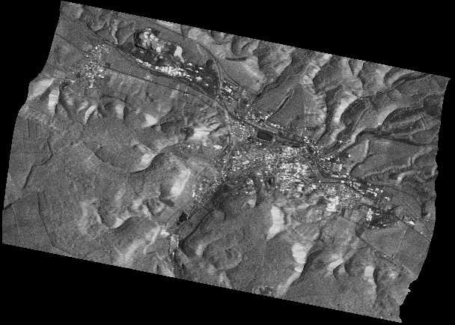
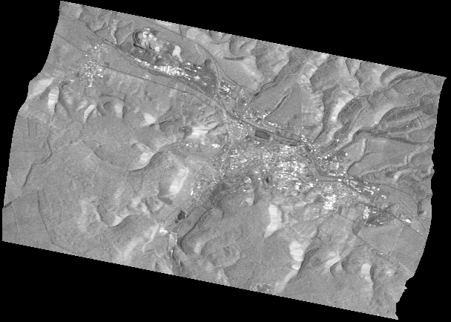
Outline
Introduction
the aperture synthesis in azimuth (SAR), forming baseline (SAR Interferometry), the aperture synthesis in elevation (TomoSAR)
SAR Tomography Basics
TomoSAR imaging geometry & data stack, TomoSAR estimations: reflectivity profiles, tomographic cube & slices, TomoSAR aspects: tomographic aperture, coordinate system & 3D resolution cell
Factors Affecting Tomographic SAR imaging
tomographic aperture, system bandwidth, sensor wavelength, scattering mechanisms, polarization, weather & season
Mathematical Formulation of Tomographic SAR imaging
TomoSAR imaging model, linear system equation, reconstruction of the reflectivity profiles (inversion), constraints & factors to consider for the inversion, inversion algorithms
Advanced Techniques
Polarimetric SAR Tomography, Differential SAR Tomography
Case Studies
Forest, Urban, Ice & Snow, Agriculture Imaging
References & Further Reading

Slide 3
Introduction

Slide 4

Synthetic Aperture Radar: the aperture synthesis in azimuth
A_{az}
synthetic aperture
in azimuth
Let’s remember what SAR stands for:
Synthetic Aperture Radar
The key factor that is utilized in SAR is to synthesize a much longer antenna in azimuth direction by making use of the motion of the SAR sensor in order to achieve finer resolution.
flight
path
θ_{l}
range
swath
azimuth
near range
far
range
θ_{l} : look angle
ground
range
SAR imaging geometry

Slide 5

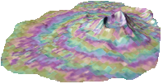
SAR Interferometry: forming baseline
Now let’s remember how SAR Interferometry works:
SAR Interferometry (InSAR) makes use of the phase difference between two complex valued images from different view angle, i.e. forming baseline, so that topography of the area can be imaged.
Baseline
B
Δr
B_{p}
θ_{l}
The limitations of InSAR:
It can not separate the contribution of multiple targets from the same range resolution cell,
The reconstruction of a DEM for the areas with steep slopes, e.g. building facades, can fail due to layover.
To overcome such limitations:
SAR techniques using multiple acquisitions, which involve variations of the view angle (multi-baselines) were developed.
r₂
r₁
topography
reference datum
B : baseline
B_{p} : perpendicular baseline
θ_{l} : look angle
r₁ & r₂: range distance for the respective acquisitions
Δr : range difference
SAR interferometry imaging geometry

Slide 6
SAR Tomography: the aperture synthesis in elevation with multiple baselines
track n
track n-1
If more tracks are added to form multi-baselines so that a new aperture in elevation can be synthesized, higher resolution in elevation can be achieved (similar to the aperture synthesis in azimuth)
master track
track 1
The principle of aperture synthesis in elevation (3D imaging) is called:
SAR Tomography (TomoSAR)
which uses both phase and amplitude information to locate the backscattering positions in elevation.
synthetic aperture
in elevation
azimuth
Since SAR signal can penetrate through canopy, soil, snow and ice, TomoSAR allows for the estimation of volumetric properties, e.g. biomass, ice thickness…
ground
range
SAR tomography imaging geometry

Slide 7


SAR Tomography Basics

Slide 8
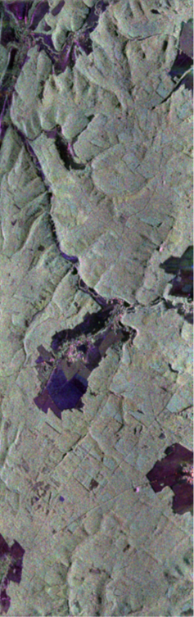

SAR Tomography imaging geometry & data stack
SAR Tomography uses multiple acquisitions from slightly different viewing angles forming an aperture in elevation and locates the scatterers along the elevation which is perpendicular to the radars line of sight.
elevation aperture
r_{n}
r_{n-1}
θ_{l}
r₀
r₁
The implementation of TomoSAR methods requires:
co-registration of the SLCs with sub-pixel accuracy so that the range-azimuth position corresponds to the same area on the ground
scatterers are located on this plane, which is orthogonal to the slant range
the residual component of the interferometric phase, e.g. atmospheric artifacts, platform motion, must be estimated and subtracted from the phase of the slave SLCs.
stack of
co-registered SLCs
r₀ : slant range of the master track
r₁…r_{n} : slant range of the slave tracks
θ_{l} : look angle
SAR tomography imaging geometry

Slide 9
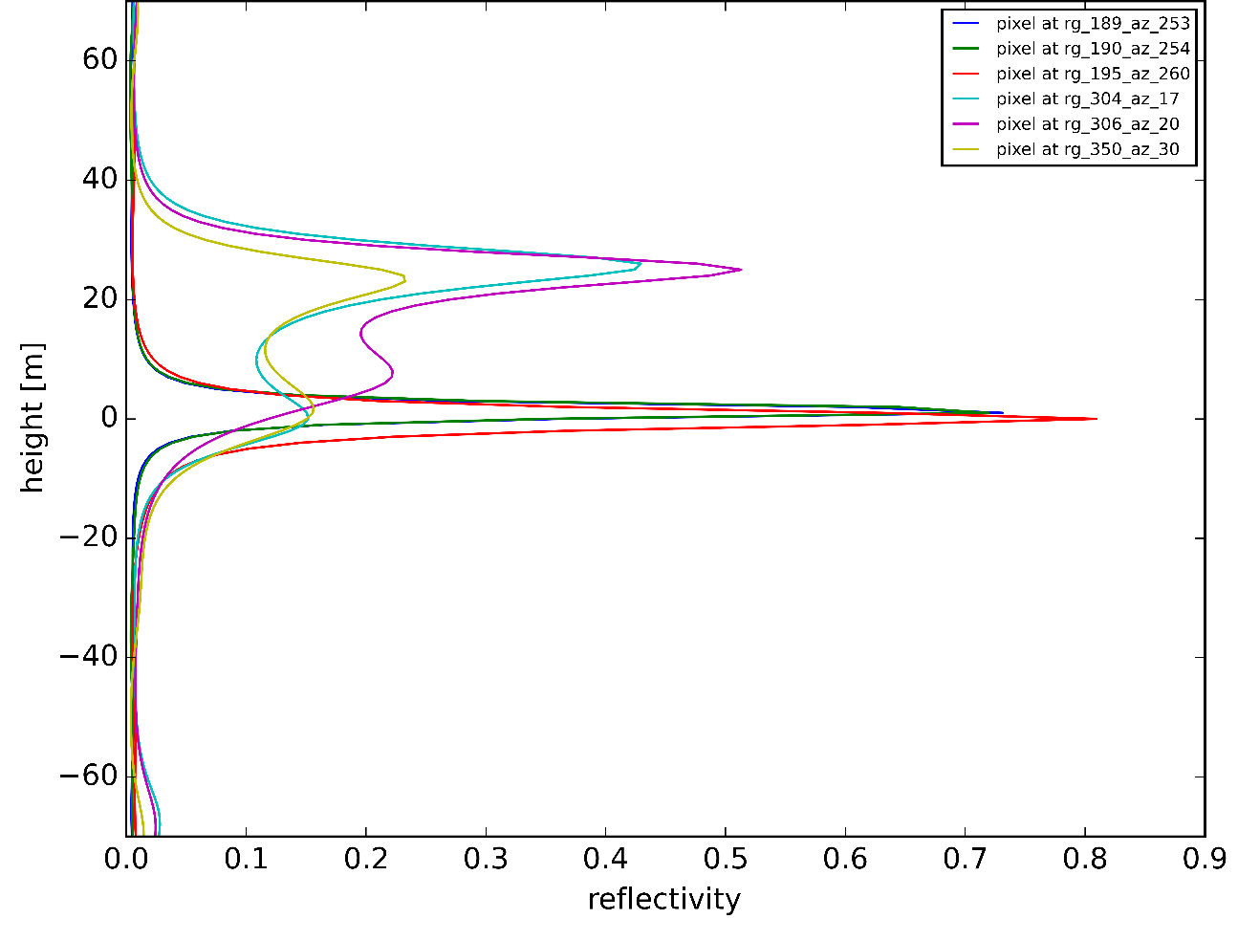
SAR Tomography estimations - reflectivity profiles
TomoSAR algorithms reconstruct for each azimuth-range pixel
the scene’s reflectivity function in elevation.
Reflectivity profiles of 6 pixels. (The profiles are normalized)
canopy
ground
reflectivity profile
along elevation

Slide 10
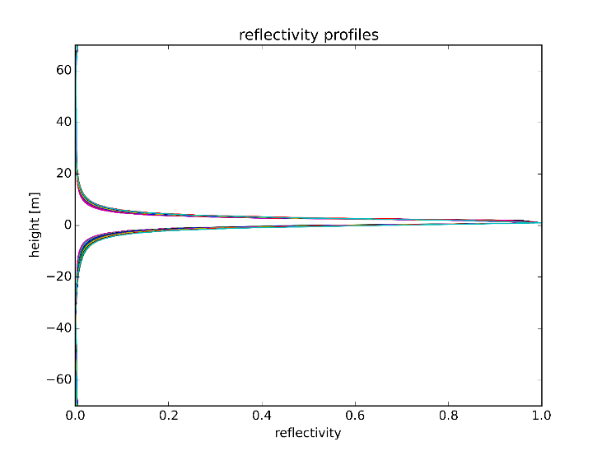
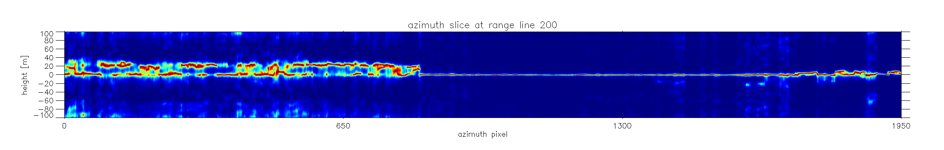
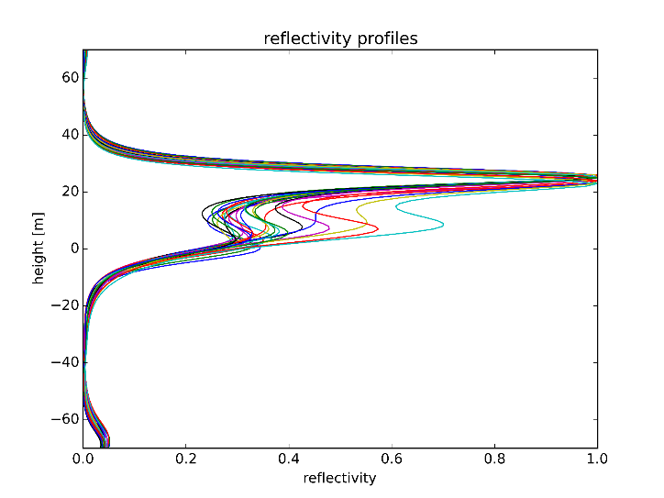
SAR Tomography estimations: TomoSAR cube & tomographic slices
The reflectivity profiles of every pixel form a TomoSAR cube, whose voxels are defined by the resolution in azimuth, slant & cross-range.
reflectivity profiles
In order to visualize the result, usually slices of this data cube are plotted.
azimuth slice: slice parallel to the azimuth dimension
range slice: slice parallel to the range dimension
horizontal slice: slice parallel to the horizontal plane
the color on tomographic slices:
dark blue: min. power, dark red: max. power (phase center)
TomoSAR cube
range slice
azimuth slice
ground
forest
(The slices and the profiles
are normalized for each pixel)
azimuth
range

Slide 11
SAR Tomography aspects: tomographic aperture & coordinate system
A_{cr}
Tomographic aperture ($Acr$) : the maximum distance between the SAR acquisitions
tomographic aperture
r_{n}
r_{n-1}
θ_{l}
r₀
TomoSAR coordinate system :
azimuth: flight direction (orthogonal to the page) slant range: radar’s line of sight (with a look angle from nadir) cross range: direction that is orthogonal to the slant range
r₁
slant range
cross-range
cross range
azimuth
slant-range
A_{cr} : cross range (tomographic) aperture
r₀ : slant range of the master track
r₁…r_{n} : slant range of the slave tracks
θ_{l} : look angle

Slide 12
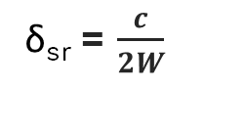
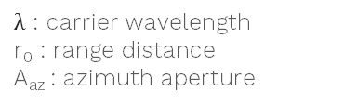
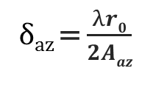
SAR resolution cell - resolution in azimuth & slant range
A SAR pixel = sum of all contributions within the resolution cell
range
with the azimuth resolution being a function of the aperture in azimuth
azimuth
δ_{az} = $\frac{λr0}{2Aaz}$
cross-range
Azimuth
resolution
azimuth
$λ$ : carrier wavelength
r₀ : range distance
A_{az} : azimuth aperture
slant-range
transmitted
pulse
with the slant-range resolution depending on the bandwidth
δ_{az}
δ_{sr}
δ_{sr} = $\frac{c}{2W}$
Slant-range
resolution
c : speed of light
W : pulse bandwidth
SAR resolution cell
[Ferro-Famil, 2015]

Slide 13
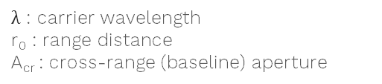
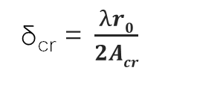
SAR Tomography aspects- resolution in cross range
With the multiple tracks in elevation the SAR resolution cell is split into multiple layers in cross-range based on the tomographic aperture A_{cr}
A_{cr}
cross-range
Cross-range
resolution
δ_{cr} = $\frac{λr0}{2Acr}$
azimuth
$λ$ : carrier wavelength
r₀ : range distance
A_{cr} : cross-range (baseline) aperture
slant-range
the resolution cell for single baseline has contribution
both from the canopy and the ground
δ_{cr}
this tomographic resolution cell has reflectance
only from the canopy
this tomographic resolution cell has reflectance only from ground
SAR resolution cell
Tomographic SAR resolution cell
[Ferro-Famil, 2015]

Slide 14
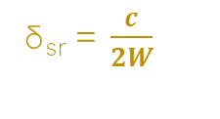
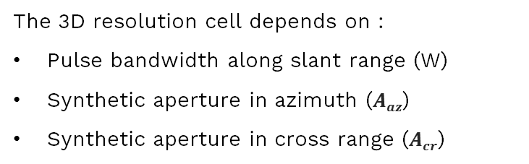
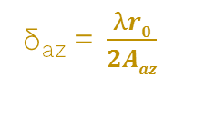
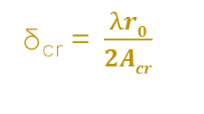
3D resolution cell
The 3D resolution cell depends on :
Pulse bandwidth along slant range (W)
Synthetic aperture in azimuth ($Aaz$)
Synthetic aperture in cross range ($Acr$)
A_{cr}
cross-range
azimuth
cross-range (s)
slant-range
δ_{az} = $\frac{λr0}{2Aaz}$
δ_{az}
δ_{sr}
δ_{sr} = $\frac{c}{2W}$
δ_{cr} = $\frac{λr0}{2Acr}$
δ_{cr}
δ_{z}
= δ_{cr}* sin(θ_{l})
azimuth(x)
θ_{l}
slant-range(r)
Tomographic SAR resolution cell

Slide 15

Factors Affecting SAR Tomography Imaging

Slide 16
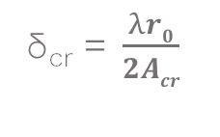
The effect of tomographic aperture
A_{cr}
A_{cr}
cross-range
cross-range
azimuth
azimuth
slant-range
slant-range
smaller tomographic aperture
lower resolution
larger tomographic aperture
finer resolution
Cross range
resolution
δ_{cr} = $\frac{λr0}{2Acr}$

Slide 17
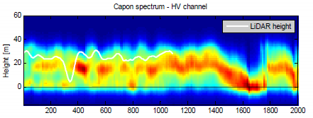
The effect of system bandwidth
slant range resolution is inversely proportional to the system bandwidth!
A_{cr}
150 Mhz Bandwidth/7 tracks
cross-range
azimuth
transmitted pulse
with large bandwidth
slant-range
δ_{sr}
cross-range
canopy
ground
reflectivity
[Papathanassiou, 2013]

Slide 18
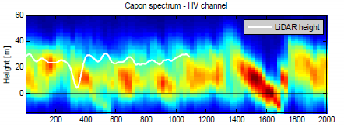
The effect of system bandwidth
low range resolution can degrade
the ability to resolve the vertical structure!
A_{cr}
150 Mhz Bandwidth/7 tracks
cross-range
transmitted pulse
with small bandwidth
azimuth
slant-range
δ_{sr}
elevation
6 Mhz Bandwidth/7 tracks
canopy
ground
reflectivity
[Papathanassiou, 2013]

Slide 19
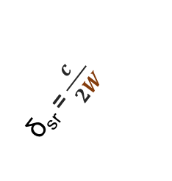
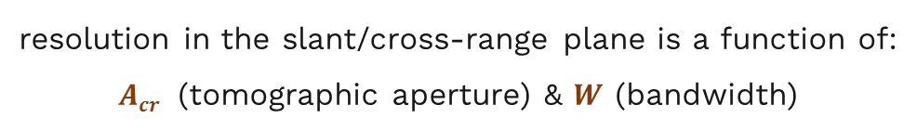
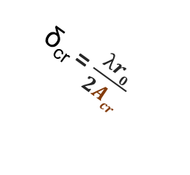
The effect of tomographic aperture & system bandwidth - summary
resolution in the slant/cross-range plane is a function of:
$Acr$ (tomographic aperture) & $W$ (bandwidth)
A_{cr}
cross-range
cross
range
δ_{sr} = $\frac{c}{2W}$
azimuth
slant-range
δ_{cr} = $\frac{λr0}{2Acr}$
small tomographic aperture
small bandwidth
slant
range
small tomographic aperture
large bandwidth
large tomographic aperture
large bandwidth
large tomographic aperture
small bandwidth
[Tebaldini, 2012]

Slide 20
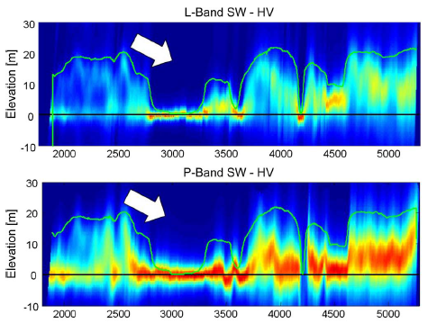
The effect of different sensor wavelength
Since the penetration depth depends on the wavelength of the sensor, the tomographic profiles differ accordingly. For example, in general in a forested area the phase center elevation at L-band is higher than at P-band.
L-band - HV
P-band - HV
C-band
X-band
P-band
L-band
Tomographic profiles of L-band and P-band in HV polarization over a boreal forest. The white arrow indicates the looking angle, and green line is the LIDAR forest height [Tebaldini & Rocca 2012].

Slide 21
The effect of different scattering mechanisms
backscatter from the canopy
transmitted
pulse
Different scattering mechanisms (SM) result in different reflectivity profiles. For example, forest scenarios can be characterized by : double-bounce, surface and volume scattering mechanisms.
canopy-ground scattering
trunk-ground
scattering
trunk-ground: double bounce SM with ground locked phase center (the peak of the reflectivity)
ground & canopy-ground : surface SM with ground locked phase center
reflectivity
backscatter from the ground
canopy
canopy: volume SM with phase center located above the ground, depending on the canopy height, and the associated reflectivity curve is spread along the cross-range
trunk- ground
canopy- ground
ground
height
[Tebaldini, 2012]

Slide 22
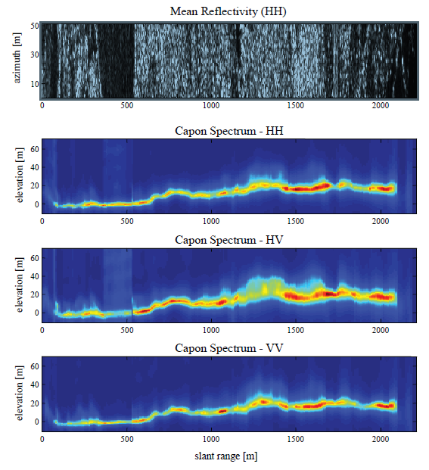


The effect of different polarization
ground
forest
V
type of polarization affects the sensitivity to different scattering mechanisms.
H
co-polarization (HH, VV) is more sensitive to the surface scattering and double-bounce, whereas cross-polarization (HV, VH) is more to the volume
Tomographic analysis of the three polarization channels with Capon spectra as reported in [Tebaldini, 2012] : HH, HV and VV
HH & VV: characterized by a narrow phase center located mainly at the ground which relates to the scattering mechanisms of double bounce contribution from trunk-ground and canopy-ground interactions
(vegetation is barely visible)
HV : the contribution from the vegetation, relating to the volumetric scattering, is more visible in HV but contribution from ground is still dominant
[Tebaldini, 2012]

Slide 23
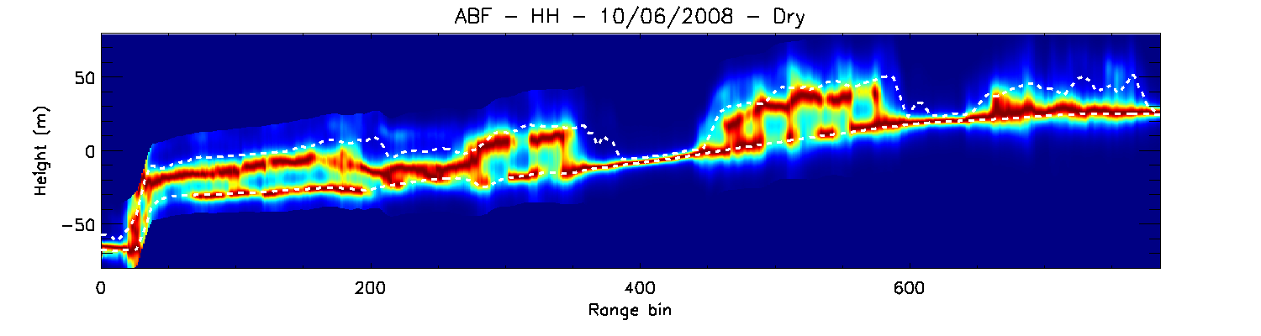
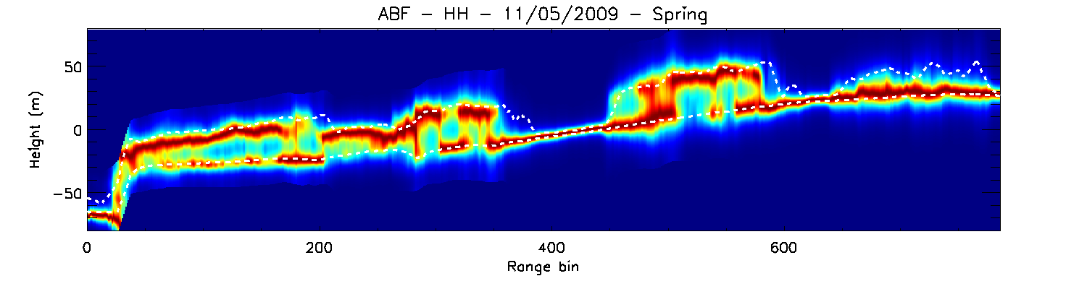
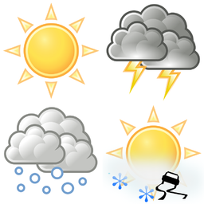

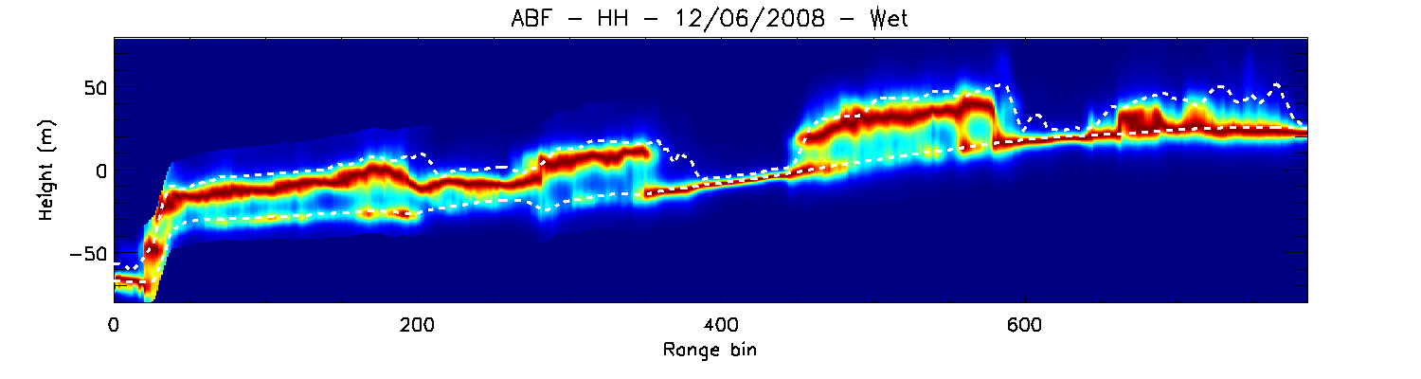
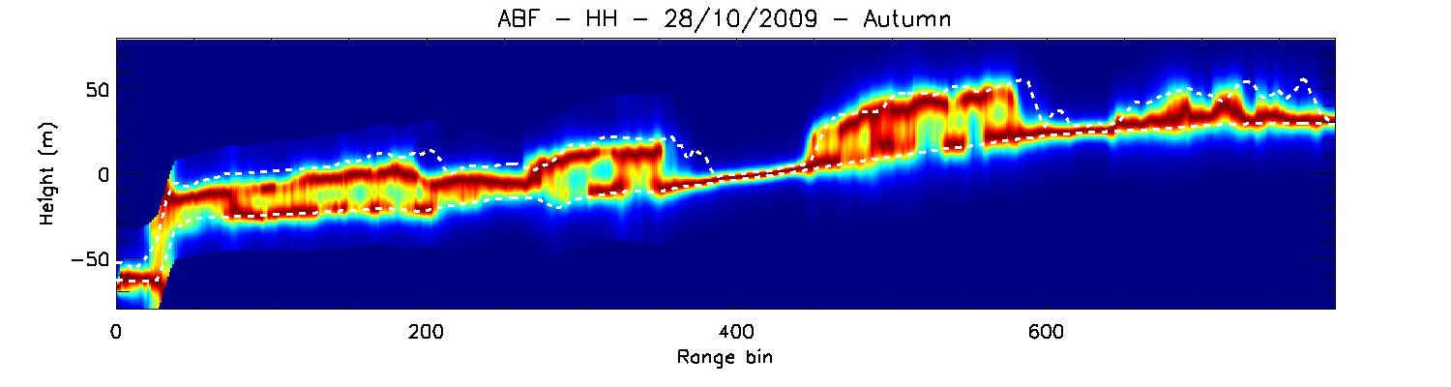
The effect of weather & season
3D distribution of the reflectivity is influenced by
weather: due to the dielectric properties of the target
season: leaf-on, leaf-off conditions
According to a case study by [Pardini et al. 2014] over a temperate forest, Traunstein, Germany:
tomographic slices before & after a rainfall
tomographic slices in spring & autumn
after rain:
The ground power is reduced w.r.t the canopy power
The height of the phase center (red areas) is increased
leaf off:
The ground power is increased w.r.t the canopy
LIDAR
LIDAR
LIDAR
LIDAR
LIDAR

Slide 24

Mathematical formulations & Inversion Algorithms

Slide 25
The TomoSAR imaging concept : tomographic stack
Let‘s assume that our dataset is a stack of N SAR images :
All the slaves are co-registered to a master
The flat-earth phase is compensated at each slave
(as well as the contributions from atmosphere, platform motion etc.)
Reflectivity information based on elevation is encoded
in the N number of pixels at position (x, r)
range
N
y₁
y₂
y₃
.
.
y_{N}
azimuth
y_{N} =
P(x, r)
Nx1
y_{N}: measurement vector containing the N number of complex pixel values at location (x,r)
P(x, r) : pixel in x^{th} row at azimuth and r^{th} column in range
N : number of tracks (number of acquisitions)

Slide 26

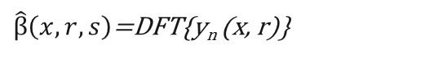
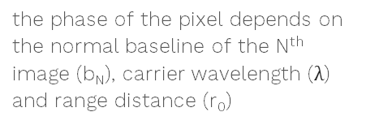
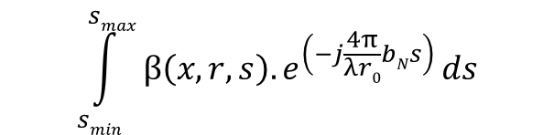
The TomoSAR imaging model
The TomoSAR imaging model can be formulated as a simple principle:
a Fourier relation exists between SAR data and the target projection
b
$$\int_{smin}^{smax}{β\left(x,r,s\right).e^{\left(−j\frac{4π}{λr0}bNs\right) }ds}$$
n^{th}
image
y_{n} (x, r) =
master
b_{n}
θ_{l}
the complex pixel value from N^{th} SAR images at the azimuth (x) and range coordinates (r)
SAR reflectivity along the cross-range (s) for pixel (x,r)
the phase of the pixel depends on the normal baseline of the N^{th} image (b_{N}), carrier wavelength ($λ$) and range distance (r₀)
s
Hence the reflectivity distribution can be retrieved by performing the Discrete Fourier transform (DFT) of the observable vector (y_{n}) with respect to the normal baseline
$\hat{β}\left(x,r,s\right)$=DFT{y_{n} (x, r)}
[Ferro-Famil, 2015]
However with this equation,
proper reconstruction of the vertical profiles of the scene requires uniform distribution of the baselines
the limited number of passes often results in a strongly undersampled observable vector
r
reference surface s=0

Slide 27
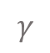

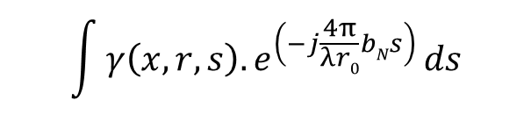
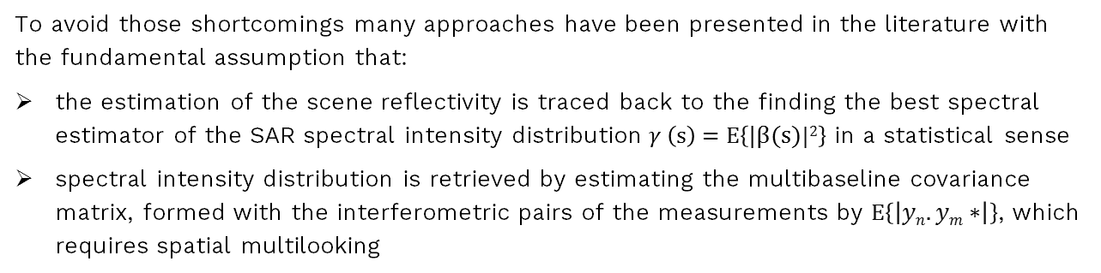
The TomoSAR imaging model
To avoid those shortcomings many approaches have been presented in the literature with the fundamental assumption that:
the estimation of the scene reflectivity is traced back to the finding the best spectral estimator of the SAR spectral intensity distribution $γ \left(s\right)=E\left\{|β(s)|2\right\}$ in a statistical sense
spectral intensity distribution is retrieved by estimating the multibaseline covariance matrix, formed with the interferometric pairs of the measurements by $E\left\{\left|yn.ym∗\right|\right\}$, which requires spatial multilooking
b
n^{th}
image
master
b_{n}
θ_{l}
The equation for TomoSAR imaging model can be rewritten as:
s
$$\int{γ\left(x,r,s\right).e^{\left(−j\frac{4π}{λr0}bNs\right) }ds}$$
R_{n} (x, r) =
$$γ$$
Covariance between the slave image y_{n}(x,r) and the master image
Spectral intensity distribution
the phase of the pixel depends on the normal baseline of the N^{th} image (b_{N}), carrier wavelength ($λ$) and range distance (r₀)
r
reference surface s=0

Slide 28
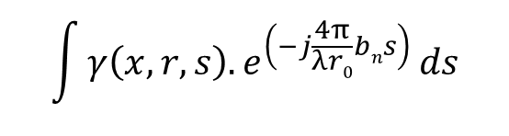
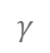
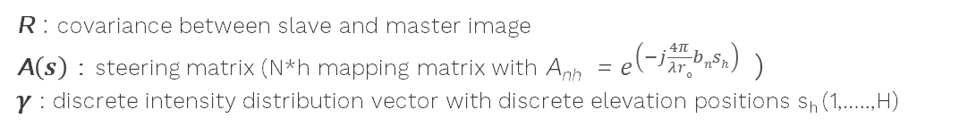
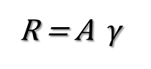
The linear system equation
TomoSAR imaging model can be approximated by discretizing the intensity distribution
N
$$\int{γ\left(x,r,s\right).e^{\left(−j\frac{4π}{λr0}bns\right) }ds}$$
R_{n} (x, r) =
Discretizing the elevation profile
leads to a linear system equation
h
reflectivity profile
R = A $γ$
$$γ$$
h : number of discretization
R : covariance between slave and master image
A$\left(s\right)$ : steering matrix (N*h mapping matrix with A_{nh} = $e^{\left(−j\frac{4π}{λr0}bnsh\right) }$)
$γ$ : discrete intensity distribution vector with discrete elevation positions s_{h} (1,…..,H)

Slide 29
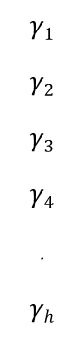
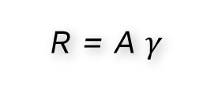
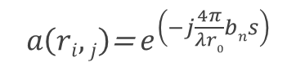

Reconstruction of the reflectivity profile : Inversion
→ The task of TomoSAR is to reconstruct the reflectivity profile $γ$ which is framed as the inversion of the linear system:
R = A $γ$
N
R
A
$$γ$$
covariances
steering matrix
unknown reflectivity profile
R₁
R₂
R₃
R₄
.
R_{N}
…
…
…
…
…
…
$$γ1$$
$$γ2$$
$$γ3$$
$$γ4$$
.
$$γh$$
a(r_{1,1})
a(r_{2,1})
a(r_{3,1})
a(r_{4,1})
.
a(r_{N,1})
a(r_{1,h})
a(r_{2,h})
a(r_{3,h})
a(r_{4,h})
.
a(r_{N,h})
a(r_{1,2})
a(r_{2,2})
a(r_{3,2})
a(r_{4,2})
.
a(r_{N,2})
a(r_{1,3})
a(r_{2,3})
a(r_{3,3})
a(r_{4,3})
.
a(r_{N,3})
a(r_{1,4})
a(r_{2,4})
a(r_{3,4})
a(r_{4,4})
.
a(r_{N,4})
=
h
reflectivity profile
$$γ$$
Nx1
Nxh
hx1
h : number of discretization
R_{N}: vector containing the covariances
$a\left(ri,j\right)$= $e^{\left(−j\frac{4π}{λr0}bns\right) }$
a: steering vector containing values derived by

Slide 30

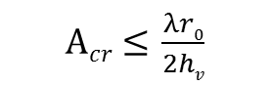

Constraints: baseline distribution, ambiguities or replicas…
due to practical constraints, the quality of the tomographic imaging degrades in terms of: resolution, height ambiguities, side lobes, etc…
A_{cr}
$$Δb$$
Height Resolution
Baseline aperture
↔
$Acr≤$ $\frac{λr0}{2hv}$
max. distance between passes
total height of the volume in cross range
large enough for high resolution
replicas
Ambiguity displacement
↔
Baseline spacing
Ambiguity occurs in the same slant-range as the real target with displacement in the cross-range by:
$\text{v}\text{a}=$ $\frac{λr0}{2Δb}$
ambiguity
displacement
min baseline spacing
reference surface s=0
h_{v}
small enough so that the ambiguity displacement is large enough to avoid mixing of real & replicas
resolution
cell
v_{a}

Slide 31

Factors to consider for the inversion
The inversion must be implemented considering certain factors including:
the distribution of the baselines
If they are uniformly distributed, the inversion can be done with discrete Fourier Transform, however, in practice it is usually not possible to achieve constant baseline between all the tracks in air- and space-borne acquisitions
the separation of the maximum baseline (tomographic aperture)
The tomographic aperture defines the resolution in elevation (larger the separation, finer the resolution), due to practical constraints, such as small orbital tube of modern SAR satellites, leading to small apertures, resolution is usually degraded
number of tracks
limited number of tracks often results in strong undersampling leading to increased side lobes
-- Varieties of inversion techniques are presented in the SAR literature dealing with such constraints --

Slide 32
Inversion algorithms (spectral estimators)
2 main families of inversion methods
Non-parametric methods
the differences between methods rely on how they deal with the problem of choosing a solution among the set of possible ones (the solution is not unique due to underdetermined character).
(Fourier Beamforming, Capon BF, Compressive Sensing,..)
Parametric methods
in order to transform the underdetermined problem into a determined one, a priori assumptions are made. The differences between the methods essentially rely on the type of assumptions
(MUSIC, Coherence Tomography, COMET, SKP,..)
Fourier Beam Forming (FBF) is Fourier transform of the data vector estimating the backscatterer power. It is coherent and energy preserving however has limited vertical resolution and prone to ambiguities if the number of tracks is low and the baselines are irregularly distributed which is usually the case for airborne and spaceborne systems.
[Capon, 2003], [Gini, 2002], [Lombardini, 2003], [Nannini, 2012]
Multiple Signal Non-linear Parametric (MUSIC) are made before the application, for instance, the number of scattering mechanisms needs to be set a priori.
[Schmitt, 1986], [Gini, 2002], [Lombardini, 2013], [Li, 2016]
Capon Beam Forming (Adaptive Beamforming - ABF) with respect to FBF, Capon can not preserve radiometric calibration, however it does not require regular distribution of baselines and can reject sidelobes efficiently.
[Capon, 2003], [Gini, 2002], [Lombardini, 2003], [Nannini, 2012]
(tutorial)
Polarimetric Coherence Tomography (PCT) employs variation of the interferometric coherence with polarization. The inversion can be linearized by using a priori knowledge, volume depth and topographic phase.
[Cloude, 2006], [Pardini, 2012]
Compressive Sensing (CS) methods have finer resolution capabilities at elevation. The disadvantage of CS is the complexity and the high computational cost.
[Budillon, 2003], Zhu, 2011], [Aguilera, 2011], [Aguilera, 2013], [Reigber, 2000], [Reigber, 2015]

Slide 33
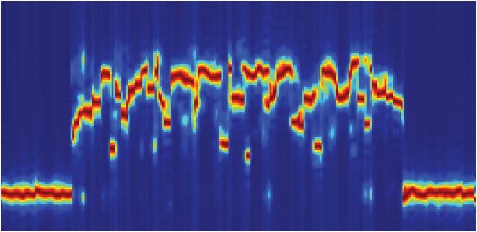
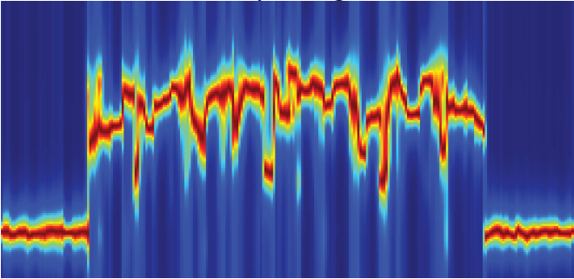
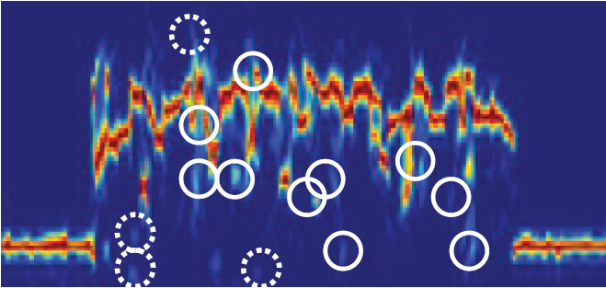
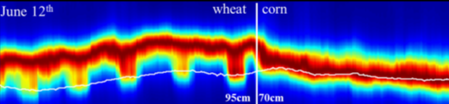
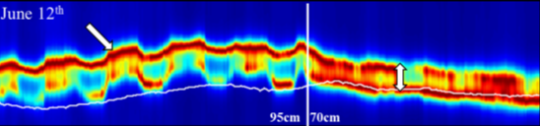
Inversion algorithms - examples
Examples of tomogram in a forest scene simulated by PolSARproSim [Tello et al. 2016].
Fourier beamforming - 35 tracks
Capon Beamforming - 6 tracks
Compressive Sensing – 6 tracks
Identified local maxima that are not present in Capon
Peaks wrongly introduced by Compressive Sensing
Examples of tomogram in an agricultural scene [Joerg et al. 2015].
Capon Beamforming – 9 tracks
MUSIC algorithm – 9 tracks

Slide 34
Advanced Techniques

Slide 35
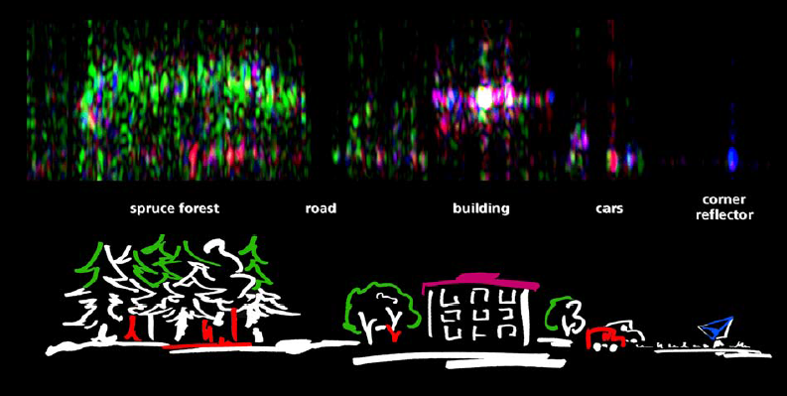
Polarimetric SAR Tomography
It is also possible to combine polarization and tomography so that different scattering contributions can be separated depending on the elevation.
L-band E-SAR data with 13 tracks, Oberpfaffanhofen, Germany
Upper image: tomographic azimuth slice with Polarimetric color composite using Pauli basis
Odd bounce = HH + VV
Even bounce = HH – VV
Volume scattering = 2*HV
Lower image: Schematic representation of the imaged area
[Reigber & Moreira 2012]

Slide 36
Polarimetric SAR Tomography
600
SAR image
An example for a polarimetric tomographic profile (corresponding to the yellow line on the SAR image) over forested area [Moreira et al. 2013]
slant range (m)
The color coding corresponds to the elements of the Pauli vector
Blue: surface scattering (HH +VV)
Red: dihedral ground trunk interaction (HH-VV)
Green: volume scattering (2HV)
0
Azimuth (m)
1500
0
20
Polarimetric tomographic profile
The tomographic stack contains:
21 L-band E-SAR images with an average baseline of 20 m.
Height (m)
0
0
Azimuth (m)
1500

Slide 37

Differential SAR Tomography : 4D & 5D imaging
SAR Tomography + Differential SAR Interferometry → Differential SAR Tomography
Differential SAR Tomography is utilized for monitoring the targets showing displacement. It allows estimating the scatterer distribution:
for displacements: in the elevation – velocity plane
(4D imaging, 3 space + 1 velocity)
for thermal dilation: in the elevation – velocity – thermal plane
(5D imaging, 3 space + 1 velocity + thermal)
Differential TomoSAR signal model (4D):
$$\int_{smin}^{smax}{γ\left(s\right).e^{\left(−j\frac{4π}{λr0}bns\right) −\left(−j\frac{4π}{λ}d(s, tN\right)} ds}$$
R_{n} =
N number of tracks acquired at different time t1…tN,
the target is located at elevation s,
to be characterized by deformation d(s,tN)
[Reale et al. 2013]
3D imaging: estimated topography [m]
4D imaging: mean velocity[cm/year]
5D imaging: thermal coefficient [cm/K]

Slide 38
Examples and Case Studies

Slide 39
Forest Imaging
SAR Tomography at longer wavelength (L-, P-band), offering 3D imaging capabilities and being sensitive to contributions from the vegetation layer and from the ground below, is precious in remote sensing of forested areas [Tello et al., 2015] , [Tebaldini et al., 2012]

Slide 40


Forest Imaging: Forest Biomass and Height with SAR Tomography [Minh et al., 2016]
The study explores the potentials of TomoSAR to retrieve Biomass and canopy height in a tropical forest.
The analysis show that the proposed TomoSAR – Biomass retrieval method is accurate even in hilly and high-biomass forest areas.
study area: tropical forest in Paracou & Nouragues, French Guayana
dataset: Full polarimetric, P-band ONERA data acquired in the frame of the ESA campaign TropiSAR 2009, spanning 5 uniform baselines with 15 meters.
Comparison between LiDAR and tomography retrieval of forest top height in both sites.
A tomographic profile at the Nouragures forest for the HV channel, white line denotes the LIDAR height measurements

Slide 41


Forest Imaging: Forest Biomass with SAR Tomography [Dinh et al., 2012]
The aim of the study is to demonstrate the use of tomographic information to retrieve tropical forest.
It was found that reflectivity at 30m ± 10m above the ground provides the best sensitivity with forest biomass in all polarizations, for biomass ranging from 250 to 450 tons/ha.
study area: tropical forest in Paracou, French Guayana
dataset: P-band ONERA data acquired in the frame of the ESA campaign TropiSAR 2009.
circles indicates the in-situ forest biomass measurements
AA’ line indicate the position of the tomographic slices
Two panels below show tomographic layers at:
ground level (h=0m)
vegetation layer (h=30m)
Tomographic reconstruction of P-band along the azimuth slice of in HH, HV and VV polarizations at AA’ in the left image.

Slide 42

Forest Imaging: Forest Structure with SAR Tomography [Tello et al., 2015]
The study explores the link between forest structure and the 3D spatial distribution of the peaks in the reflectivity profiles at L-band, proposing measures for forest structure estimation from tomographic SAR.
The comparison of inventory plots, LIDAR and TomoSAR results indicate that the horizontal and vertical variability of the tree distribution is reflected in the tomographic profiles, essentially through the 3D spatial distribution of peaks in the reflectivity.
The tomographic profile from Compressive Sensing show better resolution and lower side lobes with respect to Capon beamforming.
study area: temperate forest In Traunstein, Germany
dataset: full polarimetric, L-band E-SAR system of DLR, spanning 5 non-uniform baselines with 5-25 meters
(a)-(b) Pauli representation of the tomogram with Capon and with the Compressive Sensing.
(c)-(f) Examples of inventory plots (50x50 m) with different structures, as represented
with field, LIDAR and TomoSAR data.

Slide 43
Urban Imaging
Modern spaceborne SAR systems like TerraSAR-X, TanDEM-X, and COSMO-Skymed provide very high resolution data enabling mapping of urban infrastructure with SAR Tomography. [Zhu & Bamler, 2014]
The capabilities of SAR tomography with high resolution SAR data includes reconstruction of single buildings, the estimation of deformation mean velocity, as well as detection of thermal dilation.

Slide 44

Urban Imaging: SAR Tomography for imaging urban areas [Zhu & Bamler, 2014]
TomoSAR point cloud from 94 ascending & 79 descending TerraSAR-X images of Berlin, Germany
The study presents the concept of SL1MMER algorithm based on the inversion with Compressive Sensing for multi-dimensional imaging of Urban areas.
Also see the video: Tomographic City Tour of Berlin from Space
https://www.youtube.com/embed/BrpDRdhBhcQ?autoplay=1
TomoSAR deformation estimates around Las Vegas Convention Center
linear deformation velocity [mm/yr]
Reconstructed building facades of
Bellagio Hotel
Point cloud of Bellagio Hotel, Las Vegas generated by 25 TerraSAR-X images visualized in Google Earth (DLR)
-30
0

Slide 45

Urban Imaging: 4D & 5D imaging [Fornaro et al., 2012]
The study investigates the application of SAR tomography to very high resolution TerraSAR-X data in order to demonstrate the potentials for monitoring of transportation infrastructures showing deformation and thermal dilation.
study area: city of Las Vegas, USA
dataset: 25 TerraSAR-X images in high resolution spotlight mode
residual topography
deformation mean
velocity
thermal dilation
coefficient
TomoSAR height estimation
-50 m
100 m

Slide 46
Urban Imaging: 4D & 5D imaging [Reale et al., 2013]
The study addresses the extension of tomographic based approaches to the monitoring of structure thermal dilation.
Aspects related to,
detection of the scatterers
estimation of the thermal coefficient beside the topography and deformation mean velocity
are investigated.
4D imaging: mean velocity[cm/year]
study area: city of Las Vegas, USA
dataset: 25 TerraSAR-X images in high resolution spotlight mode
3D imaging: estimated topography [m]
5D imaging: thermal coefficient [cm/K]
Estimated thermal coefficient [mm/K]

Slide 47
Ice/Snow Imaging
SAR tomography offers an opportunity to observe the internal structure of glaciers and polar ice sheets, to expand the knowledge and understanding of the processes related to ice formation and melting, the water movement through a glacier, and for assessing the response of the ice masses to climate forcing [Tebaldini et al., 2016].

Slide 48

Ice & Snow Imaging : Estimation of Ice penetration depth [Banda et al., 2014]
The study addresses quantitative analysis of the penetration depth of P-band SAR signal into ice subsurface.
study area: ablation zone of South-West Greenland
dataset: Airborne P-band POLARIS data in HH polarization
ground range slice
tomographic section obtained by Capon estimator at 40 m below the vertical phase center.
azimuth slice
The white lines denote the upper and lower ice boundaries as estimated by the MUSIC algorithm [Banda et al. 2014]

Slide 49


Ice & Snow Imaging : Imaging internal structure of glacier [Tebaldini et al., 2016]
The study reports the analysis of L-band airborne TomoSAR application for imaging the internal structure of a glacier.
Various sub-surface features including firn bodies, crevasses, layer transition, bedrock reflection down to 50 m below the ice surface, observed in GPR (Ground Penetrating Radar) are also captured in TomoSAR slices.
study area: Mittelbergferner glacier, Austrian Alps
dataset: Airborne L-band data in HH and HV polarization
Ground Ranging Radar
Ground Ranging Radar
Vertical stripes are observed ranging from the ice surface to about 20 m in depth with increased amplitudes, which are typical features indicating crevasses
The bedrock underneath homogeneous ice appears as very sharp reflection due to strong gradients in dielectric properties at the transition ice–rock.

Slide 50
Agriculture Imaging
The scattering mechanisms in agricultural vegetation are rather complex due to the different species, orientation of the vegetation volume and very fast changes in the structure of the vegetation over the phenological cycle.
SAR tomography can be utilized to resolve the scattering processes in the vertical direction, to separate the ground and volume backscattering and to interpret the effect of physical changes of species, phenological state, etc [Joerg et al., 2015].

Slide 51



Agriculture Imaging: Polarimetric Tomography for Phenological Changes of Agricultural Crops [Joerg et al., 2017]
The study investigates the impact of changes in agriculturally vegetated areas on the scattering signatures at different frequencies.
The main challenges of monitoring of agricultural vegetation include:
high resolution and high accuracy required
many influencing parameters, e.g. crop height, soil moisture & roughness, vegetation water content, orientation characteristics etc..
complex scattering scenario
Corn
Wheat
Barley
July 03
JULY 3
$\sim 1.9m$ $\sim 0.9m$ $\sim 0.8m$
Corn
Wheat
Barley
Corn
Corn
Wheat
Barley
Corn
Crop Height [m] at data acquisition
X-BAND
ρ_{z}=0.5m
9 tracks
4m
HH
VV
0m
4m
HH
VV
C-BAND
ρ_{z}=0.8m
9 tracks
0m
study area:
Wallerfing, Germany
dataset:
Airborne X, C-,L-band
F-SAR data in
Quad polarization
4m
HH
VV
L-BAND
ρ_{z}=1.2m
8 tracks
Capon Slices
multi-look cell 7.5⨯7.5m
(X-/C-band: 220 looks,
L-band: 100 looks)
0m
ρ_{z} : vertical
resolution
0
1
450m
450m

Slide 52



Agriculture Imaging: Polarimetric Tomography for Phenological Changes of Agricultural Crops [Joerg et al., 2017]
The study reports that even though the Rayleigh resolution in height is in the range of the vegetation heights,
changes in the scattering characteristics could be detected
the differences between the species and the stages of the phenological cycle, growth & penetration capabilities, could be observed.
Corn
Wheat
Barley
July 03
JULY 24
$\sim 1.9m$ $\sim 0.9m$ $\sim 0.8m$
Corn
Wheat
Barley
Corn
Corn
Wheat
Barley
Corn
X-BAND
ρ_{z}=0.5m
9 tracks
4m
HH
VV
July 24
0m
4m
HH
VV
$\sim 3.5m$ $\sim 0.8m$ $0m$
C-BAND
ρ_{z}=0.8m
9 tracks
Crop Height [m] at data acquisitions
0m
study area:
Wallerfing, Germany
dataset:
Airborne X, C-,L-band
F-SAR data in
Quad polarization
4m
HH
VV
L-BAND
ρ_{z}=1.2m
8 tracks
Capon Slices
multi-look cell 7.5⨯7.5m
(X-/C-band: 220 looks,
L-band: 100 looks)
0m
ρ_{z} : vertical
resolution
0
1
450m
450m

Slide 53
Agriculture Imaging: Polarimetric Tomography for Phenological Changes of Agricultural Crops [Joerg et al., 2017]
Interpretations:
Corn
X- and C-band:
Similar characteristics are observed at X- and C-band while the profiles at X-band show more volume contribution.
In the corn, the growth and the morphological change of the plants are observed.
In the wheat, the dryout can be observed by the main peak of the vertical profiles moving from the top of the plant closer to the ground from one date to the other.
The extent of the vertical profiles in both dates are, however, smaller than the actual plant height indicating that also high frequencies penetrate into the vegetation.
Wheat
L-band:
In contrast to higher frequencies, L-band is not as sensitive to low vegetation and the vertical profiles are in general more ground dominated.
The vertical resolution is lower than at the higher frequencies which makes it more difficult to distinguish between contributions at different heights, particularly for low plant height.
Additionally in the corn, on July 24th, VV has an increased sensitivity to the vegetation compared to HH where ground contribution is more dominant.
Barley

Slide 54
References & Further Reading

Slide 55
References & Further Reading
TomoSAR General
Aguilera (a), E., Nannini, M, and Reigber, A. (2013), “A Data-Adaptive Compressed Sensing Approach to Polarimetric SAR Tomography of Forested Areas”. IEEE Geoscience and Remote Sensing Letters, Vol. 10, No. 3, pp. 543–547.
Aguilera (b), E., Nannini, M, and Reigber, A. (2013), “Wavelet-based compressed sensing for SAR tomography of forested areas”. IEEE Trans. Geosci. Remote Sens., Vol. 51, No. 12, pp. 5283–5295.
Budillon, A., Evangelista, A. and Schirinzi, G. (2011), “Three-dimensional SAR focusing from multipass signals using compressive sampling,” IEEE Trans. Geosci. Remote Sens., vol. 49, no. 1, pp. 488–499.
Capon, J. (2003). “High resolution frequency wavenumber spectrum analysis”. Proceedings of the IEEE, Vol. 150, No. 3, pp. 125-134.
Cloude, S. (2006), “Polarization Coherence Tomography,” Radio Science, vol. 41, RS4017.
Danisor, C., Fornaro, G., & Datcu, M. (2016). “Inversion Algorithms and PS Detection in SAR Tomography, Case Study of Bucharest City”. Telfor Journal, 8, 1.
Ferro-Famil, L. (2015). PolSARpro 2015 Lectures, ESA-ESRIN, Frascati(Rome), Italy, 19-23 January 2045.
Fornaro, G. (2014). ”Tomographic SAR”. NATO SET-191 Lecture Series, Bucharest, 10-11 November.
Fornaro, G. & Pascazio, V., (2013). “SAR Interferometry and Tomography: Theory and Applications”, Academic Press Library in Signal Processing vol. 2, Elsevier Ltd.
Gini, F., Lombardini, F. and Montanari, M. (2002), “Layover solution in multibaseline SAR interferometry,” IEEE Transactions on Aerospace and Electronic Systems, vol. 38, pp. 1344–1356.
Li, X., Liang, L., Guo, H. and Huang, Y. (2016). “Compressive Sensing for Multibaseline Polarimetric SAR Tomography of Forested Areas”, IEEE Transactions on Geoscience and Remote Sensing, Vol. 54, No. 1, pp. 153-166.
Lombardini, F. and Reigber, A., (2003) “Adaptive spectral estimation for multibaseline SAR tomography with airborne L-band data,” Proceedings of International Geoscience and Remote Sensing Symposium, vol. 3, pp. 2014–2016.
Lombardini, F., Cai, F. and Pasculli, D., (2013), “Spaceborne 3-D SAR Tomography for analyzing garbled urban scenarios: Single-look superresolution advances and experiments,” IEEE Journal of Selected Topics in Applied Earth Observations and Remote Sensing, vol. 6, no. 2, pp. 960–968.

Slide 56
References & Further Reading
TomoSAR General
Moreira, A., Prats-Iraola, P., Younis, M., Krieger, G., Hajnsek, I., & Papathanassiou, K. P. (2013). “A Tutorial on Synthetic Aperture Radar”. IEEE Geoscience and Remote Sensing Magazine, 1, pp. 6-43.
Nannini, M. , Scheiber, R. , Horn, R. and Moreira, A., (2012), “First 3-D reconstructions of targets hidden beneath foliage by means of Polarimetric SAR Tomography,” Geoscience and Remote Sensing Letters, IEEE, vol. 9, no. 1, pp. 60–64.
Papathanassiou, K. (2013). 4th Advanced Training Course in Land Remote Sensing Slides, 01 - 05 July 2013, Harokopio University, Athens, Greece
Pardini, M., Torano-Caicoya, A., Kugler, F., Lee, S. K., Hajnsek, I. and K. Papathanassiou, (2012), “On the estimation of forest vertical structure from multibaseline polarimetric SAR data,” Proceedings of International Geoscience and Remote Sensing Symposium, pp. 3443–3446.
Reigber, A., & Moreira, A. (2000). “First Demonstration of Airborne SAR Tomography using Multibaseline L-band Data”. IEEE Transactions On Geoscience And Remote Sensing, 38, no. 5., pp. 2142-2152
Reigber, A., Nannini, M., Martinez del Hoyo, A., (2015), “A Comparative Study of Tomographic SAR Focusing Methods”, Proceedings on the 12th European Radar Conference, pp. 29-32
Richards, J. (2009). “Remote Sensing with Imaging Radar”. Springer, pp 209-217.
Schmidt, R. (1986), “Multiple emitter location and signal parameter estimation”. IEEE Transactions on Antennas and Propagation, Vol. 34, No. 3, pp. 279-280.
Tebaldini, S. (2012). “Remote Sensing of Biomass - Principles, chapter: Forest Structure Retrieval from Multi-Baseline SARs”. Temilola Fatoyinbo, InTech, pp. 28-58
Zhu, X. and Bamler, R., (2010), “Tomographic SAR Inversion by L1-norm Regularization – The Compressive Sensing Approach”, IEEE Trans. on Geoscience and Remote Sensing, Vol. 48, No. 10, pp. 3839 – 3846

Slide 57
References & Further Reading
Forest Imaging
Minh, D.H.T, Toan, T. L., Rocca, F., Tebaldini, S., Villard, L., Rejou-Mechain, M., Phillips, O. L. , Feldpausch, T. R., Dubois-Fernandez, P., Scipal, K. Chave, J. (2016). “SAR tomography for the retrieval of forest biomass and height: Cross-validation at two tropical forest sites in French Guiana”. Remote Sensing of Environment, 175, 138-147.
Pardini, M., Cantini, A., Lombardini, F., & Papathanassiou, K. P. (2014). 3-D Structure of Forest: First Analysis of Tomogram Changes due to Weather and Seasonal Effects at L-band. Proc. of EUSAR, June 2014, Berlin.
Schmitt, M., Shahzad, M., & Zhu, X. (2015). „Reconstruction of individual trees from multi-aspect TomoSAR data”. Remote Sensing of Environment, 165, 175-185.
Tebaldini, S., & Rocca, F. (2012). “Multibaseline Polarimetric SAR Tomography of a Boreal Forest at P- and L-Bands”. IEEE Transactions on Geoscience and Remote Sensing, 50, No.1.
Tello, M., Cazcarra-Bes, V., Pardini, M., & Papathanassiou, K. P. (2015). “Structural Classification of Forest By Means of L-band Tomographic SAR”. IGARSS2015, Milan, Italy, 26-31 July.
Tello, M., Cazcarra-Bes, V., Pardini, M., & Papathanassiou, K. P. (2016). “Assessment of forest structure estimation by means of SAR Tomography potentials and limitations”. IGARSS2016, Beijing, China, 10-15 July.
Ice/Snow Imaging
Banda, F., Tebaldini, S., & Rocca. (2014). “Ice Penetration Depth Estimation from Super-Resolution SAR Tomography”. Proceedings of the 11th European Radar Conference, Rome, Italy, 8-10 October, 2014.
Tebaldini, S., Nagler, T., Rott, H., & Heilig, A. (2016). “Imaging the Internal Structure of an Alpine Glaicer via L-band Airborne SAR Tomography”. IEEE Transactions on Geoscience and Remote Sensing, 54, No. 12.

Slide 58
References & Further Reading
Urban Imaging
Fornaro, G., Pauciullo, A., Reale, D., & Verde, S. (2014). Multilook SAR Tomography for 3-D Reconstruction and Monitoring of Single Structures Applied to COSMO-SKYMED Data. IEEE Journal Of Selected Topics In Applied Earth Observations And Remote Sensing, 7, 4.
Fornaro, G., Pauciullo, A., Reale, D., Zhu, X., & Bamler, R. (2012). SAR Tomography: “An Advanced Tool For 4D Spaceborne Radar Scanning with Application to Imaging and Monitoring Of Cities And Single Buildings”. IEEE Geoscience and Remote Sensing Society Newsletter.
Fornaro, G., Reale, D., and Verde, S. (2012), “Potential of SAR for Monitoring Transportation Infrastructures: an Analysis with the Multi-Dimensional Imaging Technique,” J. Geophys. Eng. 9 S1
Fornaro, G., & Serafino, F. (2006). “Imaging of Single and Double Scatterers in Urban Areas via SAR Tomography”. IEEE Transactions on Geoscience and Remote Sensing, 44, 12.
Reale, D., & Fornaro, G. (2014). “SAR Tomography for 3D Reconstruction and Monitoring”. Encyclopedia of Earthquake Engineering, Springer, pp. 1-16.
Reale, D., Fornaro, G. and Pauciullo, A. (2013). “Extension of 4-D SAR Imaging to the Monitoring of Thermally Dilating Scatterers” . IEEE Transactions on Geoscience and Remote Sensing, 51, 10.
Reale, D., Fornaro, G., A.Pauciullo, X.Zhu, & Bamler, R. (2011). “Tomographic Imaging and Monitoring of Buildings With Very High Resolution SAR Data”. IEEE Geoscience and Remote Sensing Letters, 8, 4.
Zhu, X. X., & Bamler, R. (2014). Superresolving SAR Tomography for Multidimensional Imaging of Urban Areas: Compressive sensing-based TomoSAR inversion. IEEE Signal Processing Magazine, 31, 51-58.
Zhu, X. X., & Bamler, R. (2010). Very High Resolution Spaceborne SAR Tomography in Urban Environment. IEEE Transactions on Geoscience and Remote Sensing, 48, 12.
Agriculture Imaging
Joerg, H., Pardini, M., Hajnsek, I., & Papathanassiou, K. P. (2017). “Fully Polarimetric Tomographic Time Series for Monitoring Phenological Changes of Agricultural Crops at Different Frequencies”. Proceedings of ESA POLinSAR 2017, Frascati (Rome), Italy, 23 - 27 January.
Joerg, H., Pardini, M., Hajnsek, I., & Papathanassiou, K. P. (2015). “Application Of Polarimetric SAR Tomography On Agricultural Vegetation For Scattering Characterisation”. Proceedings of ESA POLinSAR 2015, Frascati (Rome), Italy, 26 - 30 January.

Slide 59


SAR-EDU
SAR Remote Sensing Education Initiative
https://eo-college.org
F-SAR data for the SAR Tomography Tutorial is provided by DLR (German Aerospace Center)

